Slide 1
CPSC 355 Tutorials
Bitwise Instructions

Slide 2
Covered Today
Binary Representation
Converting Decimal to Binary
Converting Hex to Binary
Signed Integers
Two’s Complement

Slide 3
Covered Today
Bitwise Logical Instructions
NOT
AND
OR
XOR
AND NOT
OR NOT
XOR NOT
Conditional Instructions
SUBS
ANDS

Slide 4
Covered Today
Shift Instructions
Logical Shift Left
Logical Shift Right
Arithmetic Shift Right
Arithmetic Shift Left
Rotate Right
Sign/Zero Extend Operations
Signed Extend Byte
Unsigned Extend Byte

Slide 5
1.
Binary Representation
Ain’t so itty-bitty

Slide 6
Number Representation
Different Representations, same Number:
Decimal | Hex | Binary(unsigned)
0 | 0x0 | 0b0
1 | 0x1 | 0b1
14 | 0xe | 0b1110
15 | 0xf | 0b1111
62 | 0x3e | 0b111110

Slide 7
Decimal to Binary
Example
Khan Academy Example

Slide 8
Hex to Binary
Protip: Write out the Hex Table
Example
Khan Academy Example

Slide 9
Hex to Binary Table
Hex | Binary
0 | 0000
1 | 0001
2 | 0010
3 | 0011
4 | 0100
5 | 0101
6 | 0110
7 | 0111
Hex | Binary
8 | 1000
9 | 1001
A | 1010
B | 1011
C | 1100
D | 1101
E | 1110
F | 1111
Notes:
Start from zero, keep adding one, repeat until 16, or all four binary digits are 1’s. Then label each in binary up until 10, then start naming 10 and above with letters alphabetically. Write out this table in your exam

Slide 10
Binary to Hex
Group into groups of 4 on the right
Protip: Write out the Hex Table
Example
Khan Academy Example

Slide 11
Signed Integers
Use highest order bit for sign
Smaller range, but now has negatives
16-bit unsigned range=[0,65535]
16-bit signed range=[−32768,32767]
Change sign by Two’s complement
Example

Slide 12
One’s Complement
Also known as Logical NOT
Flip all bits

Slide 13
Two’s Complement
Changes the sign of a signed binary integer
Flip all bits
Add one
Arithmetic NOT

Slide 14
2.
Bitwise Logical
Instructions
Being Bitwise
Logically

Slide 15
NOT
Two types:
Arithmetic (two’s complement)
Bitwise Logical (one’s complement)
Syntax:
mvn xd, xm (logical not)

Slide 16
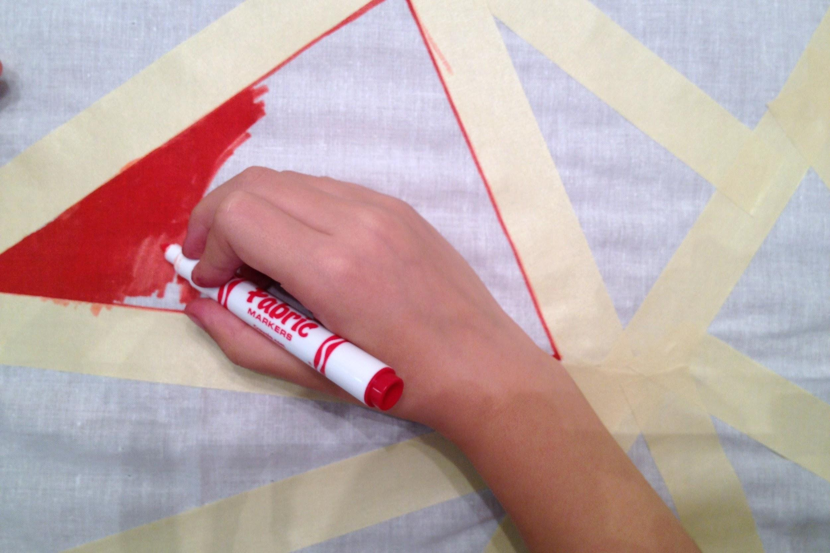
Bit masks
Affect only what you want

Slide 17
Bit Masks
Like Masking tape, registers can be set to affect specific bits
Bitmask examples (16 bits):
0xFF00 Least Significant
0x00FF Most significant 8 bits
0x7FFF Everything but the sign bit
0xFFFE Everything but the first bit
0x0180 Middle 2 bits

Slide 18
AND
Useful for isolating bits
Syntax:
and xd, xs, xm

Slide 19
Inclusive OR
Logical OR
Useful for combining registers
Useful for setting bits
Syntax:
orr xd, xs, xm
Notes:
Mov is an alias for orr xd, xzr, xm

Slide 20
Exclusive OR
Useful for toggling bits
Syntax:
eor xd, xs, xm
A | B | A⊕B
0 | 0 | 0
0 | 1 | 1
1 | 0 | 1
1 | 1 | 0

Slide 21
AND NOT
A ⋀ ~B
Useful for clearing specified bits
Syntax:
bic xd, xs, xm
A | B | A ⋀ ~B
0 | 0 | 0
0 | 1 | 0
1 | 0 | 1
1 | 1 | 0

Slide 22
OR NOT
A V ~B
Useful for moving bits and negating them
Syntax:
orn xd, xs, xm
A | B | A V ~B
0 | 0 | 1
0 | 1 | 0
1 | 0 | 1
1 | 1 | 1
Notes:
mvn is an alias for ORN xd, xzr, xm

Slide 23
XOR NOT
A ⊕ ~B
Exclusive OR
Toggle all other bits outside mask
Syntax:
eon xd, xs, xm
A | B | A⊕~B
0 | 0 | 1
0 | 1 | 0
1 | 0 | 0
1 | 1 | 1

Slide 24
2.
Conditional Instructions
Conditionally true

Slide 25
SUBS
Arithmetic operation
Compares two numbers
Sets N, Z, V, C flags
Syntax:
subs xd, xm, xn
subs xzr, xm, xn
cmp xm, xn
alias

Slide 26
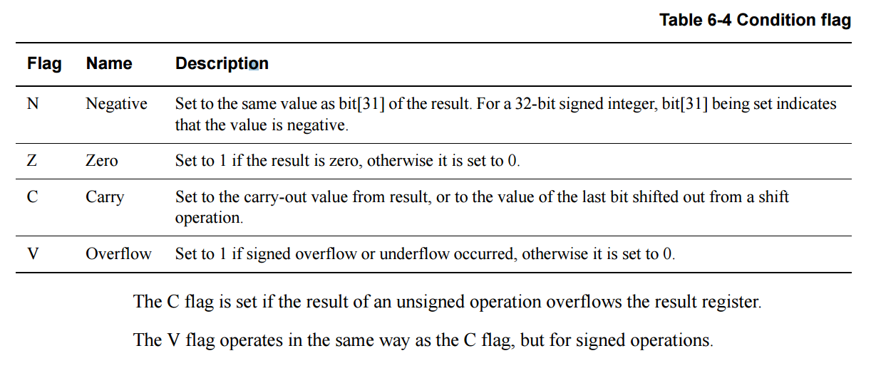
Branching Flags
ARMv8 Reference (pg 74-75)

Slide 27
ANDS
Logical bitwise instruction
Sets/clears N and Z flags
Always clears V and C flags
Test if all selected bits are set
Syntax:
ands xd, xm, xn
ands xzr, xm, xn
tst xm, xn
alias
Notes:
Mov is an alias for OR

Slide 28
3.
Shift Instructions
Shifting around

Slide 29
Logical Shift Left
Shifts all bits to the left by 1
Useful for multiplying by powers of 2
Shifted out bits are lost
Syntax:
lsl xd, xs, xm

Slide 30
Logical Shift Right
Shifts all bits to the right by 1
Useful for dividing by powers of 2
Shifted out bits are lost
Syntax:
lsr xd, xs, xm

Slide 31
Arithmetic Shift Right
Like Logical Right shift
Preserves sign bit
Syntax:
asr xd, xs, xm

Slide 32
Arithmetic Shift Left?
Does not exist!
But it just works with Logical Left Shift
Yes even for negative integers
Let's see an example

Slide 33
Rotate Right
Logical shift right, but moves shifted out bits back to the left
Syntax:
lsr xd, xs, xm
1 | 0 | 0 | 0 | 0 | 1 | 0 | 1
1 | 1 | 0 | 0 | 0 | 0 | 1 | 0
0 | 1 | 1 | 0 | 0 | 0 | 0 | 1
1 | 0 | 1 | 1 | 0 | 0 | 0 | 0

Slide 34
Rotate Left?
Does not exist, but just rotate and you get the same operation
For an 32-bit register:
Rotate left 10 = rotate right 22
e.g.
1 | 0 | 0 | 0 | 0 | 1 | 0 | 1

Slide 35
4.
Sign/Zero Extend Operations
Extending on bitwise instructions

Slide 36
Signed Extend Byte
Moves a register to a larger one
On ARMv8:
Solves problem: need to clone sign bits
 | Bits
Doubleword | 64
Word | 32
Halfword | 16
Byte | 8

Slide 37
Signed Extend Byte
Negative Numbers look different
Binary | Register Size (bits) | Decimal
0b00000011 | 8 | 3
0b111111101 | 8 | -1
0b11111111 111111101 | 16 | -1
0b11111111 11111111 11111111 111111101 | 32 | -1
0b11111111 11111111 11111111 11111111 11111111 11111111 11111111 111111101 | 64 | -1

Slide 38
Signed Extend Byte
Extends register by cloning the sign bit
Instruction | Syntax | Extends
Extend Byte | sxtb wd,wn | 8 to 16-bit
Extend Byte | sxtb xd,wn | 8 to 64-bit
Extend Halfword | sxth wd,wn | 16 to 32-bit
Extend Halfword | sxth xd,wn | 16 to 64-bit
Extend Word | sxtw xd,wn | 32 to 64-bit

Slide 39
Unsigned Extend Byte
Same as signed, but extends only zeros
Instruction | Syntax | Extends
Extend Byte | uxtb wd,wn | 8 to 16-bit
Extend Byte | uxtb xd,wn | 8 to 64-bit
Extend Halfword | uxth wd,wn | 16 to 32-bit
Extend Halfword | uxth xd,wn | 16 to 64-bit
Extend Word | uxtw xd,wn | 32 to 64-bit

Slide 40

Thanks!
Any questions?
You can find me at:
kta@ucalgary.ca
Notes:
Slides from Slides Carnival

